Slide 2

Strategic Plan:
Enhance Public/Officer Safety
Professional Development and Workforce Planning
The Appropriate Use of Technology
Quality Customer Service Delivery

Slide 3
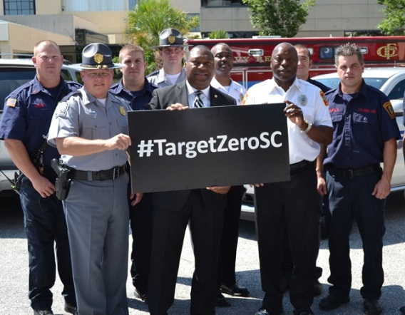
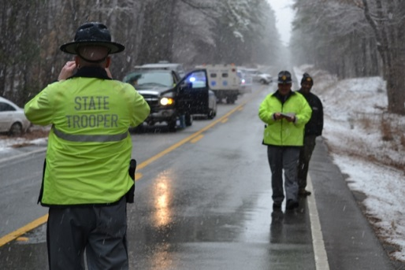
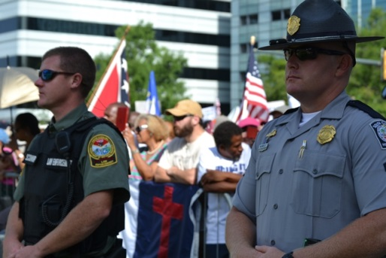
Strategy 1.1 – Protect the Public through Enforcement and Education
Goal 1: Enhance Public/Officer Safety

Slide 4
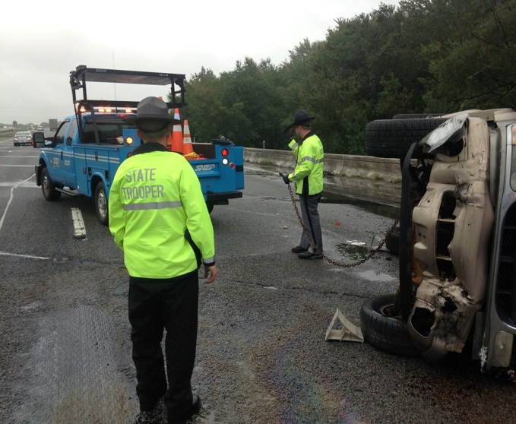
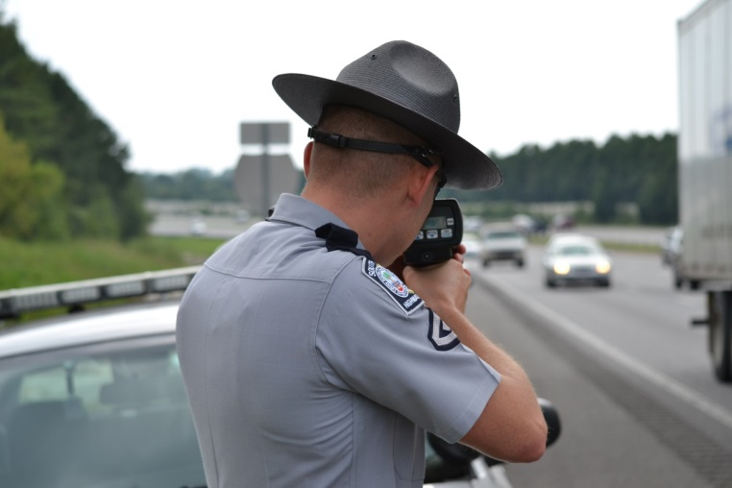
Objective 1.1.1
Annually decrease traffic fatalities toward Target Zero.
Objective 1.1.2
Decrease serious traffic injuries.
Objective 1.1.3
Decrease the number of traffic collisions.

Slide 5
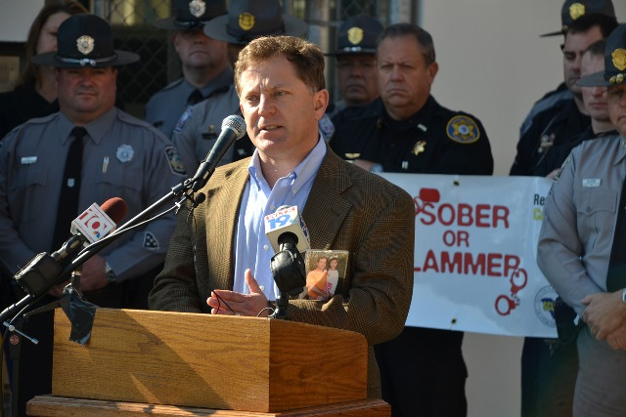
Objective 1.1.4
To improve the administration of justice, enhance public safety, and judiciously allocate resources to the victims of crime service provider community.
** Objective 4.1.2
    Enhance working relationships associated with victim services

Slide 6
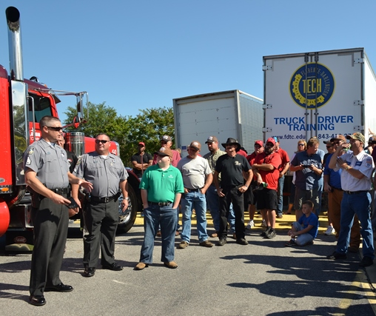
Objective 1.1.6
Annually decrease Motor coach / Passenger fatality collisions per 100 million vehicle miles traveled.
Objective 1.1.7
Annually decrease commercial motor vehicle collisions in top ten high collision corridors.

Slide 7
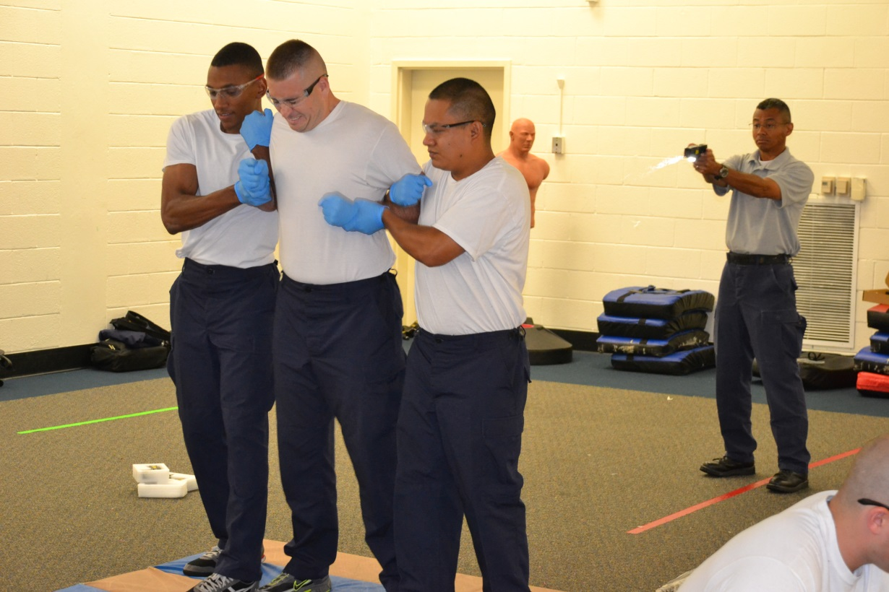
**Objective 1.2.1
Objective 1.1.8
Increase law enforcement officer safety.
Increase law enforcement officer safety.

Slide 8

Objective 1.1.9
Increase seat belt use and see a reduction in unrestrained traffic fatalities.

Slide 9
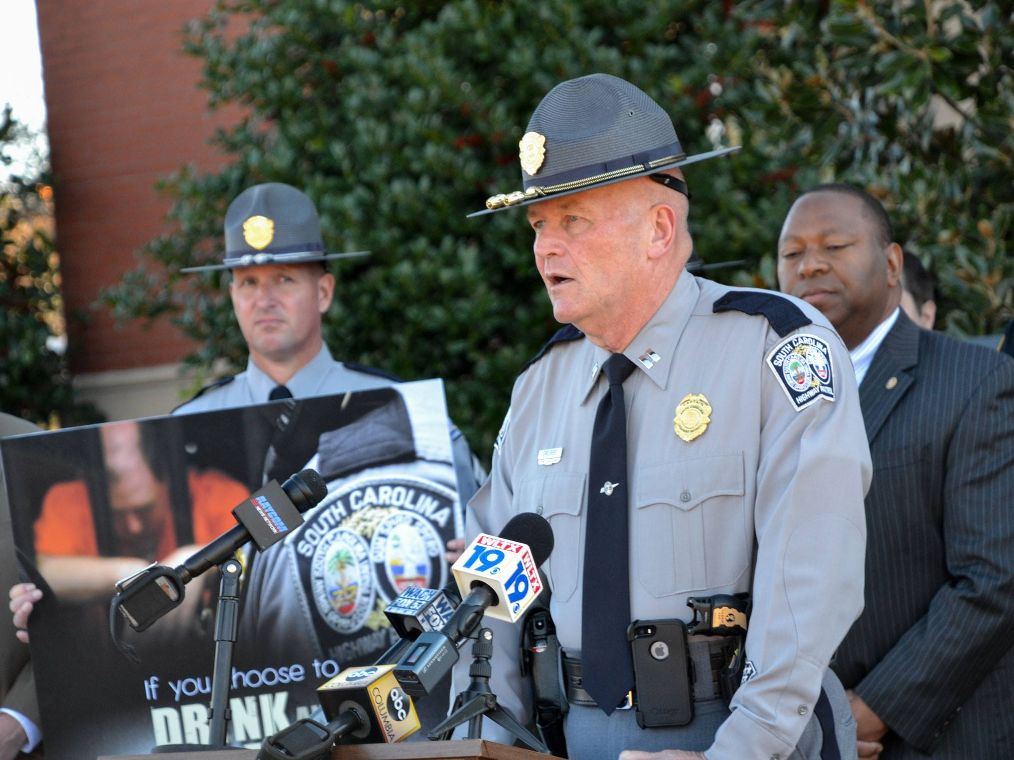
Objective 1.1.10
Informing the public of important traffic/safety matters through proactive media interviews and messaging.
Objective 4.2.5
Conduct proactive media interviews with Community Relations Officers and DPS Communications to promote highway safety and traffic issues.

Slide 10
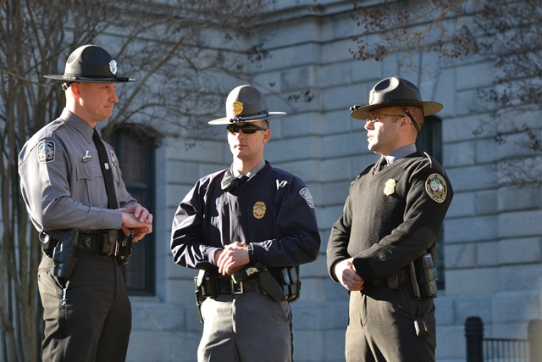
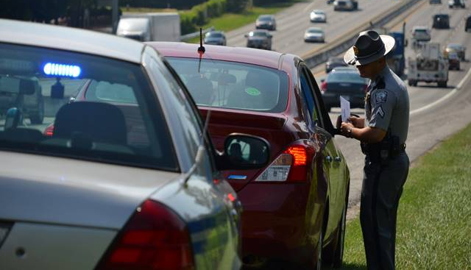
Strategy 1.2 – Protect DPS Officers through Training and Resource Commitment

Slide 11
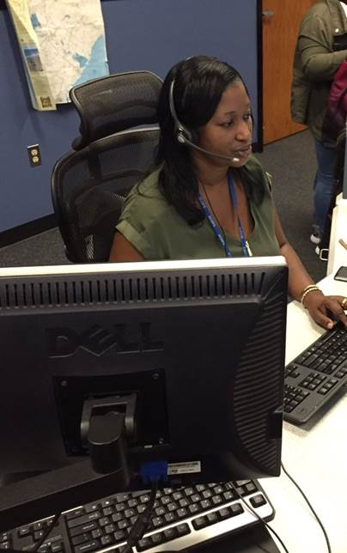
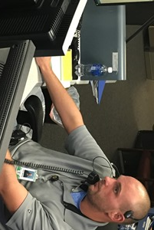
Objective 1.2.2
Improve the quality of Tele-Communications Office applicants.

Slide 12
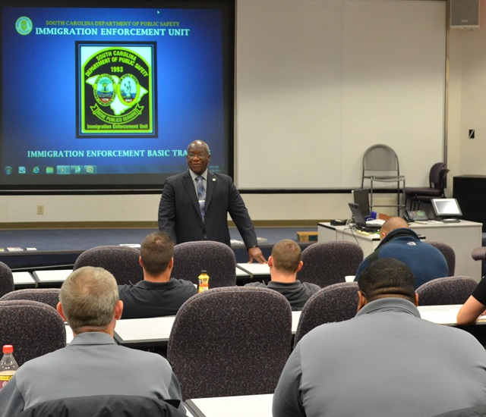
Objective 1.2.3
Assist South Carolina law enforcement and governmental agencies obtain a broader understanding of immigration laws and application.
Objective 2.2.1
** Objective 2.2.1 - Identify/host training opportunities in Human Trafficking, Fraudulent Document Recognition and Identity Fraud

Slide 13
Immigration Continued
** Goal 4: Quality Customer Service Delivery
  Strategy 4.1 - Ensure Continuous Improvement of Customer Service/Respond to Information Needs of the Public
    Objective 4.1.1 - Decrease the number of criminal related offenses involving illegal foreign nationals

Slide 14
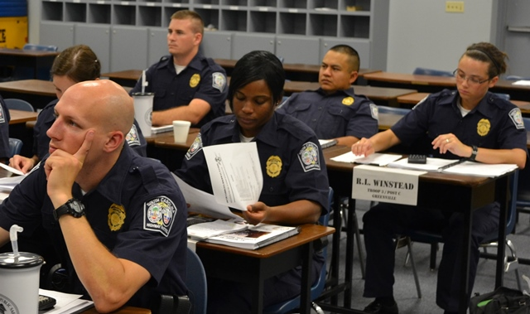
Objective 1.2.4
Reduce trooper trainee turnover

Slide 15
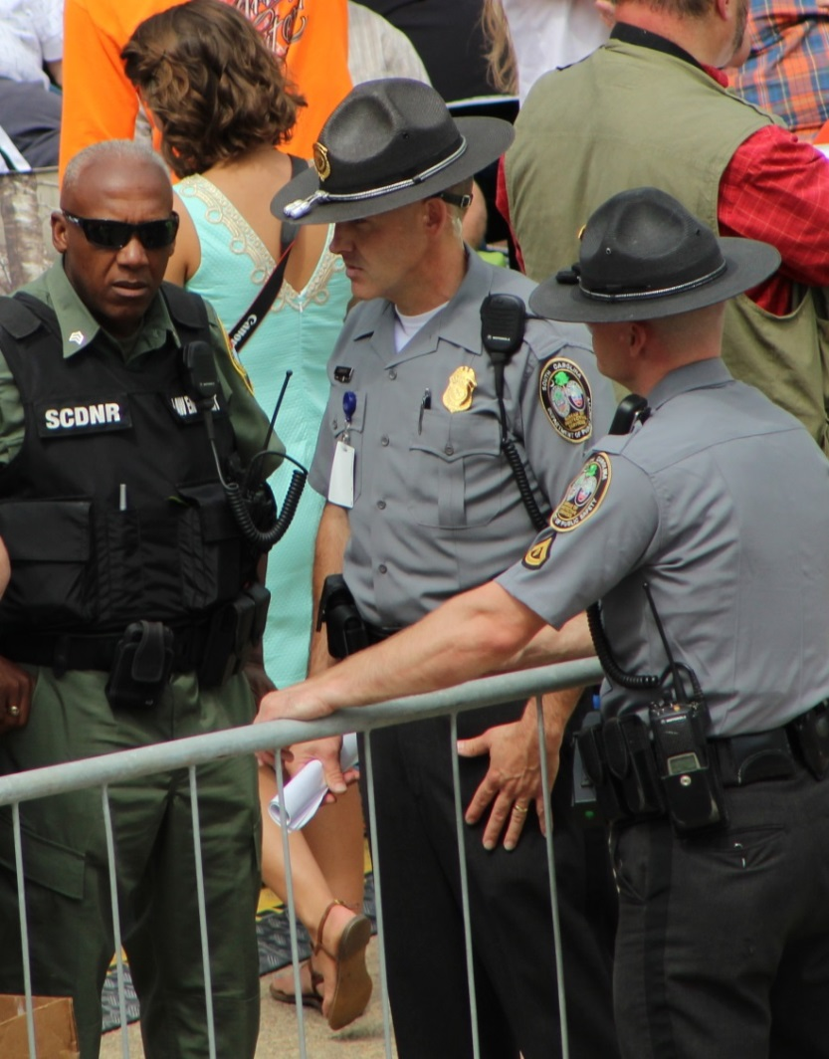
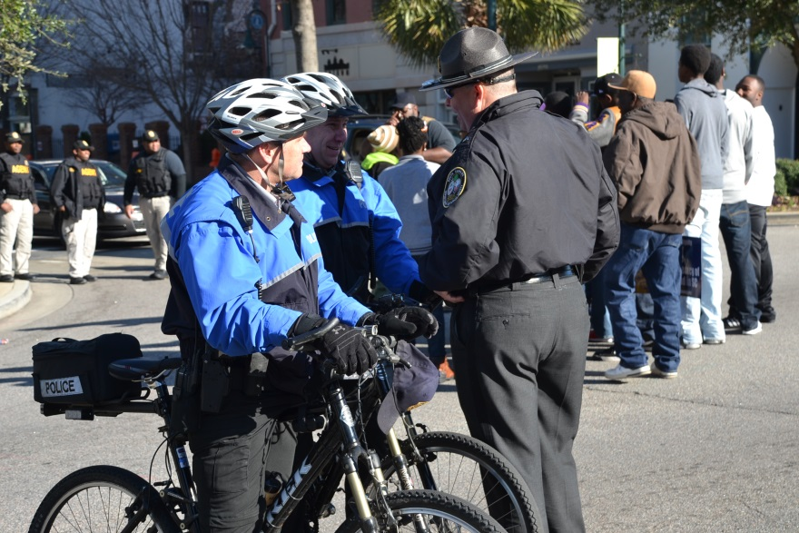
Objective 1.2.5
Train BPS officers on current emergency response plans

Slide 16
Goal 1: Potential Negative Impacts
Public is not informed of traffic safety initiatives and is unable to make prudent decisions.
Reductions in officer safety place DPS officers at risk and creates financial inefficiencies through turnover.
Not improving the quality of Tele-Communications Office applicants results in poor service to officers and poor service to the public in emergency situations and higher costs for the state.
Local agencies will not have a complete understanding of enforcement of immigration laws in their communities.
BPS not being trained on current emergency response plans places employees and visitors to state facilities at risk.

Slide 17
Goal 1: Potential Negative Impacts
Traffic Injuries result in physical pain, emotional pain, lost work, lost income, higher insurance rates, and other economic loss. Reducing traffic injuries reduces these burdens on the state.
By not efficiently administering grants and safety programs, agencies and service providers are less able to accomplish their missions of serving the public.
Traffic collisions result in fatalities, injuries, property damage and economic loss. By not reducing the number of traffic collisions, the public is subjected to these negative incidents.
Commercial traffic collisions result in loss of life, emotional pain, lost income, higher insurance rates, and other economic loss. Reducing traffic fatalities reduces these burdens on the state.
Traffic fatalities result in loss of life, emotional pain, lost income, higher insurance rates, and other economic loss. Increasing seat belt usage has proven to reduce traffic fatalities.

Slide 18
Goal 2: Professional Development and Workforce Planning

Slide 19
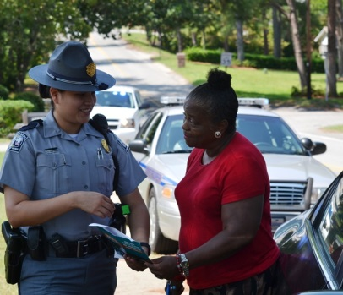

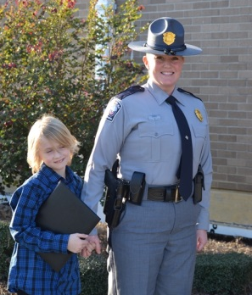
Strategy 2.1 – Attract, Recruit and Retain a Professional Workforce

Slide 20
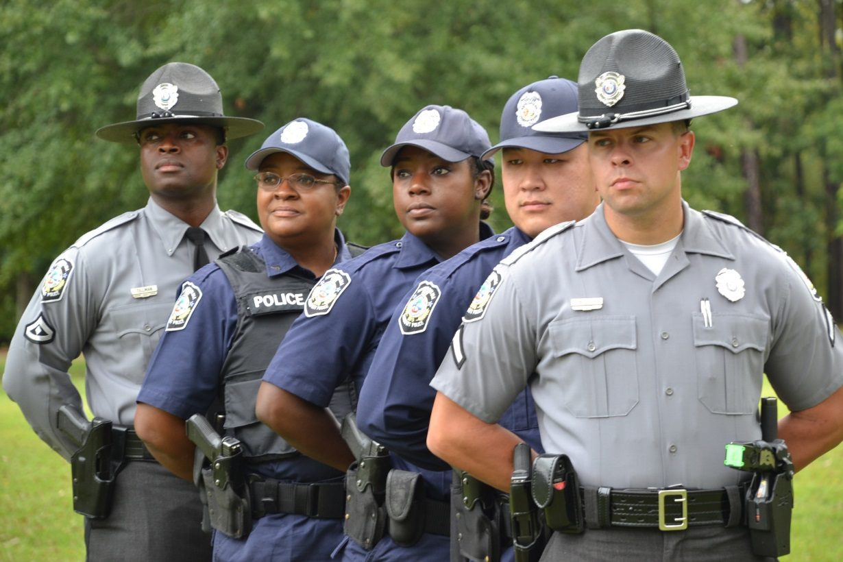
Objective 2.1.1
Increase the applicant pool of minorities.
**Objective 2.1.5
Retain current law enforcement personnel

Slide 21
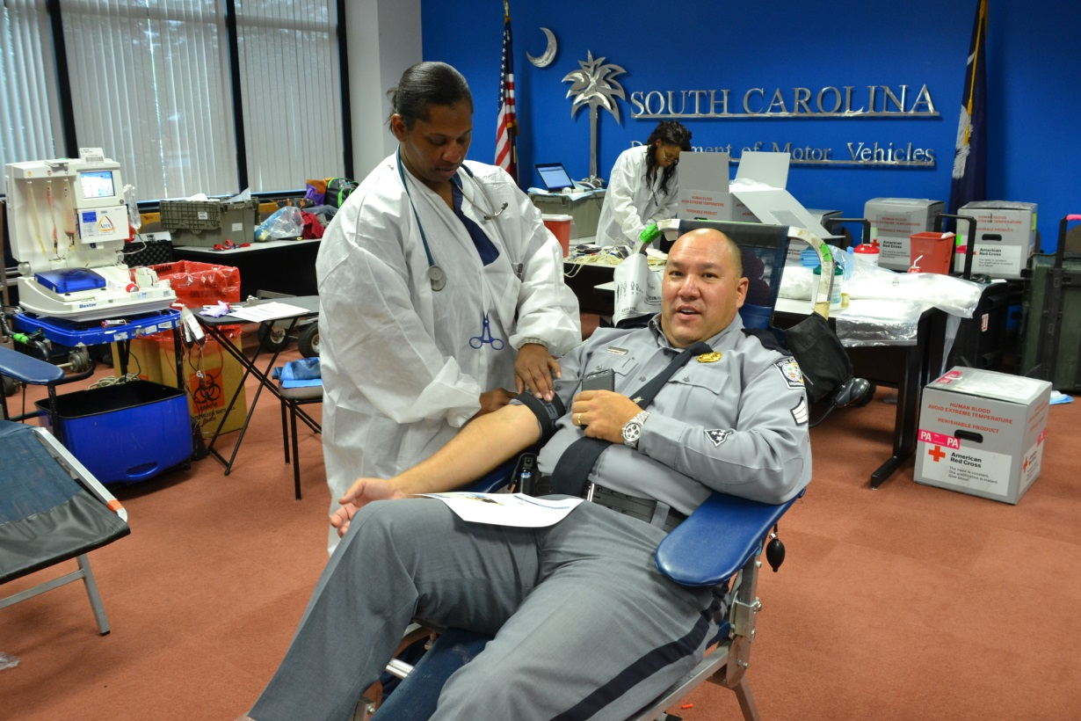
Objective 2.1.2
Offer free to low cost health screenings to agency employees.

Slide 22

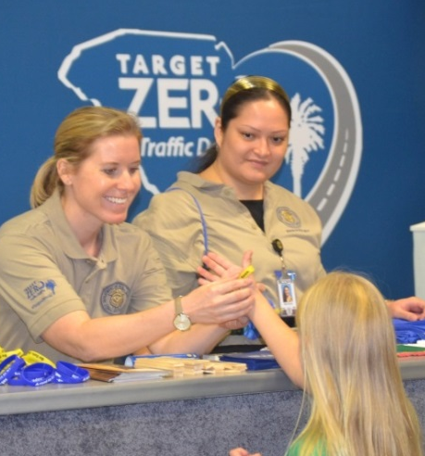
Objective 2.1.3
Increase college graduate recruits.
Objective 2.1.4
    Increase law enforcement/civilian applicant pool

Slide 23
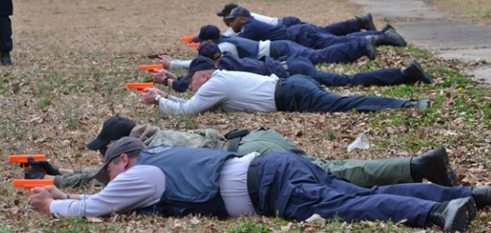
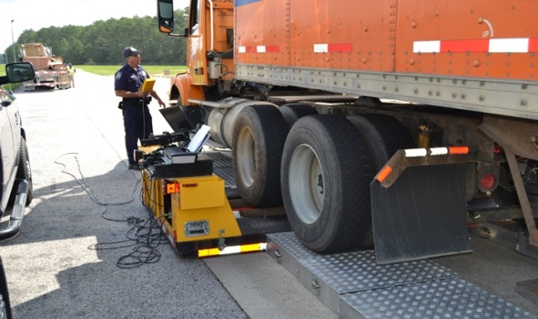
Strategy 2.2 – Enhance Employee Development

Slide 24
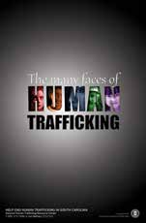
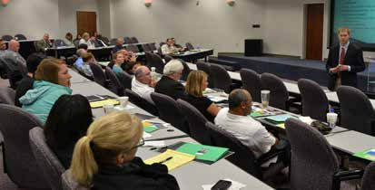
Objective 2.2.1
Identify/host training opportunities in Human Trafficking, Fraudulent Document Recognition and Identity Fraud

Slide 25
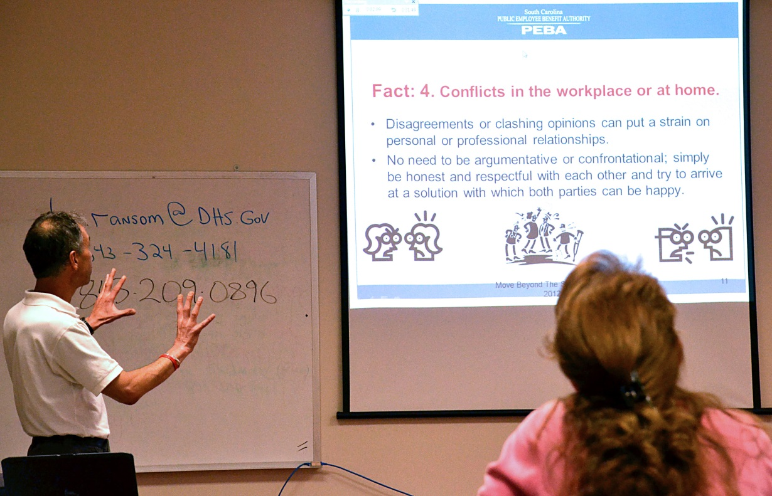
Objective 2.2.2
Develop training programs by utilizing PowerDMS and partnering with other agencies.
**Objective 2.2.5
Conduct training for civilian employees

Slide 26
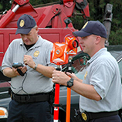
Objective 2.2.3
Provide semi-annual collision reconstruction training; host collision reconstruction accreditation examinations.
** Objective 4.1.5
Enhance Multi-disciplinary Accident Investigation Team’s (MAIT's) product quality and delivery.

Slide 27
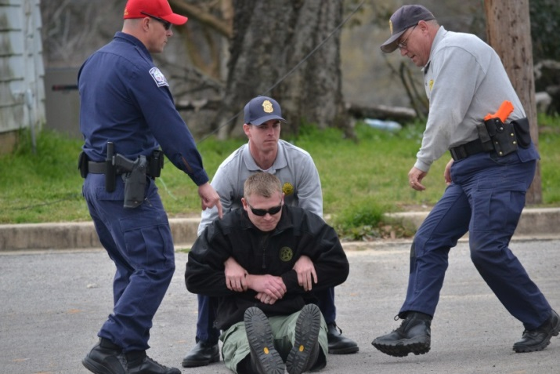
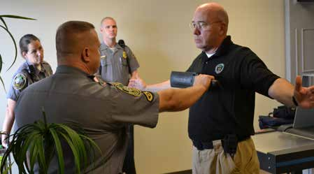
**Objective 2.2.6
Objective 2.2.4
Conduct training for troopers on victim services and victims’ rights
Conduct training on police tactics and protocols.

Slide 28
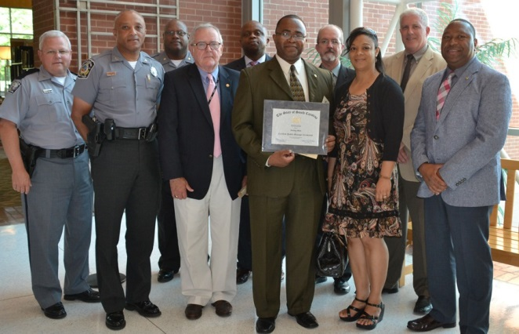
Strategy 2.3 - Enhance Leadership Development
Objective 2.3.1
  Increase the number of managers / supervisors trained in leadership and professionalism practices
Objective 2.3.2
Provide training to managers and supervisors on employment law matters affecting the agency

Slide 29
Goal 2: Potential Negative Impacts
Victims of crime will not receive the proper services that they need.
Failing to provide training to employees makes it harder for employees to learn and perform their job duties which could affect the mission of the department.
Failing to provide proper training to managers and supervisors can cause morale issues and put them in a position to not be successful and prepared for higher level positions.
Failing to provide proper training to managers and supervisors on employment law matters can put them in a position to face litigation in the event employment laws are violated.
Failing to increase an applicant pool to include college graduates limits the amount of qualified applicants to select from when filling positions.

Slide 30
Goal 2: Potential Negative Impacts
Failing to increase the applicant pool of minorities could create a workforce that is not reflective of the community in which it serves.
Failing to offer free to low cost health screenings causes employees to spend more of their salaries on health care needs which can affect their morale and personal budgets. By offering discounted screenings, the state saves on insurance costs and employees are happier and more productive.
Failing to increase an applicant pool limits the amount of qualified applicants to select from when filling positions.
By not increasing retention the number of troopers on the road will continue to decline and the agency will spend more funds trying to attract, hire and retain troopers.
Complex collision investigations do not receive the proper investigation that could be conducted.

Slide 31
Goal 3: The Appropriate Use of Technology

Slide 32
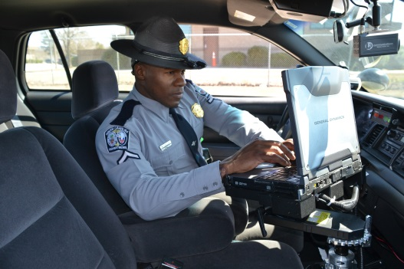
Strategy 3.1 – Heighten Information Technology Security

Slide 33

Objective 3.1.1
Achieve and maintain documented/assessed compliance with known information security requirements
Objective 3.1.2
Compliance with federal, state, and other requirements for information security

Slide 34
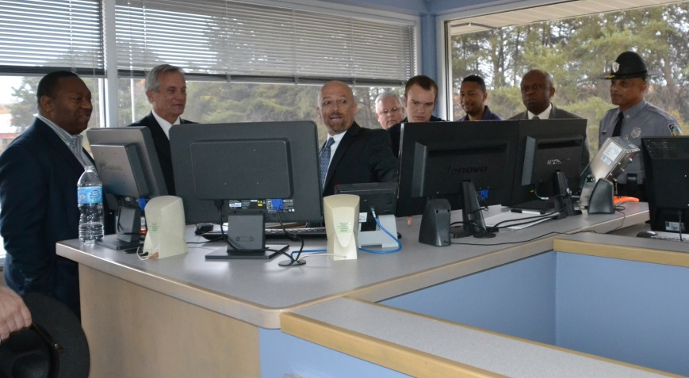
Strategy 3.2 – Utilize Technology Sufficiently to Support S.C.DPS’ Mission

Slide 35
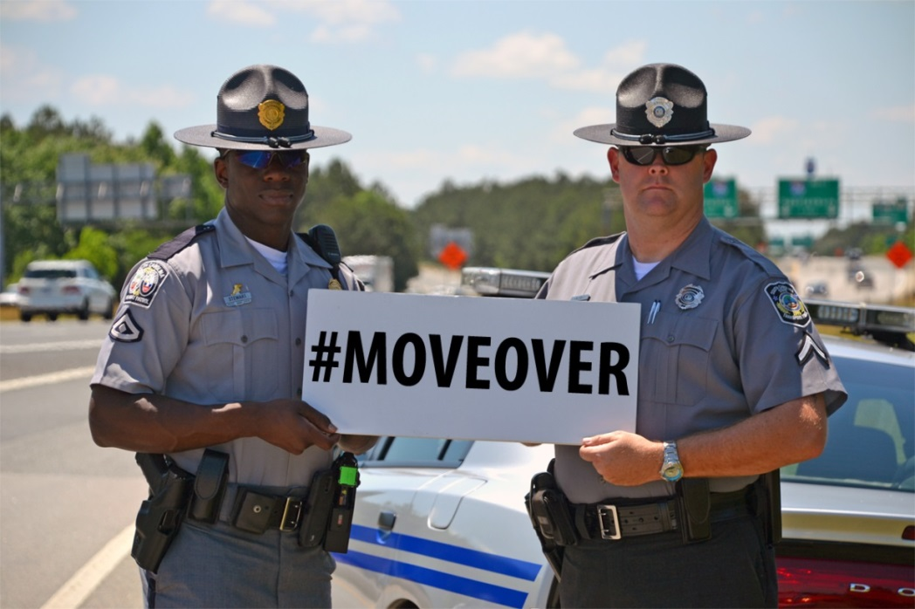
Objective 3.2.1
Increase traffic to DPS social media sites to communicate safety messages to the media/public
**Objective 3.2.2 , **4.1.3
An increase in the use of DPS' social media (traffic and safety information)
**Objective 3.2.3, **4.1.4
Increase visits to the DPS web page by the media/public to gain important traffic/safety information

Slide 36
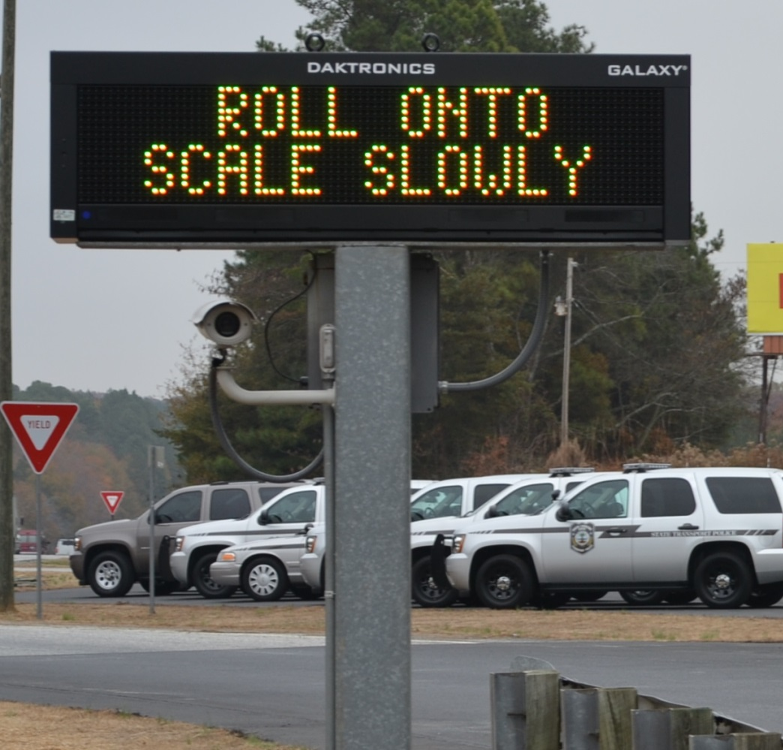
Objective 3.2.4
Delivery of efficient technology solutions and services.
Objective 3.2.5
Maximize the availability of core computing systems through lifecycle management.

Slide 37
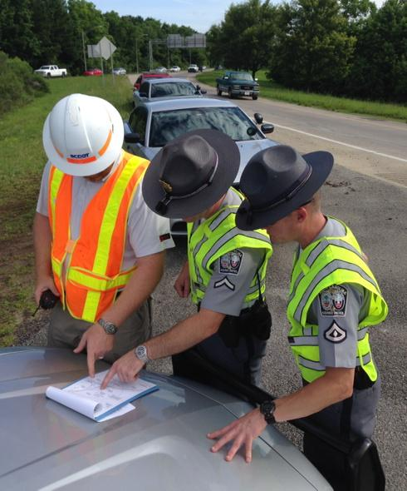
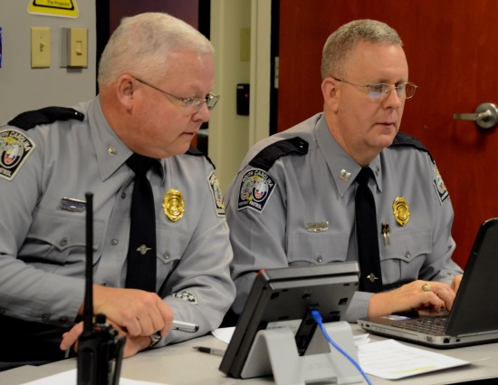
Objective 3.2.6
Improve law enforcement efficiency in emergency evacuations/traffic management during hurricanes.

Slide 38
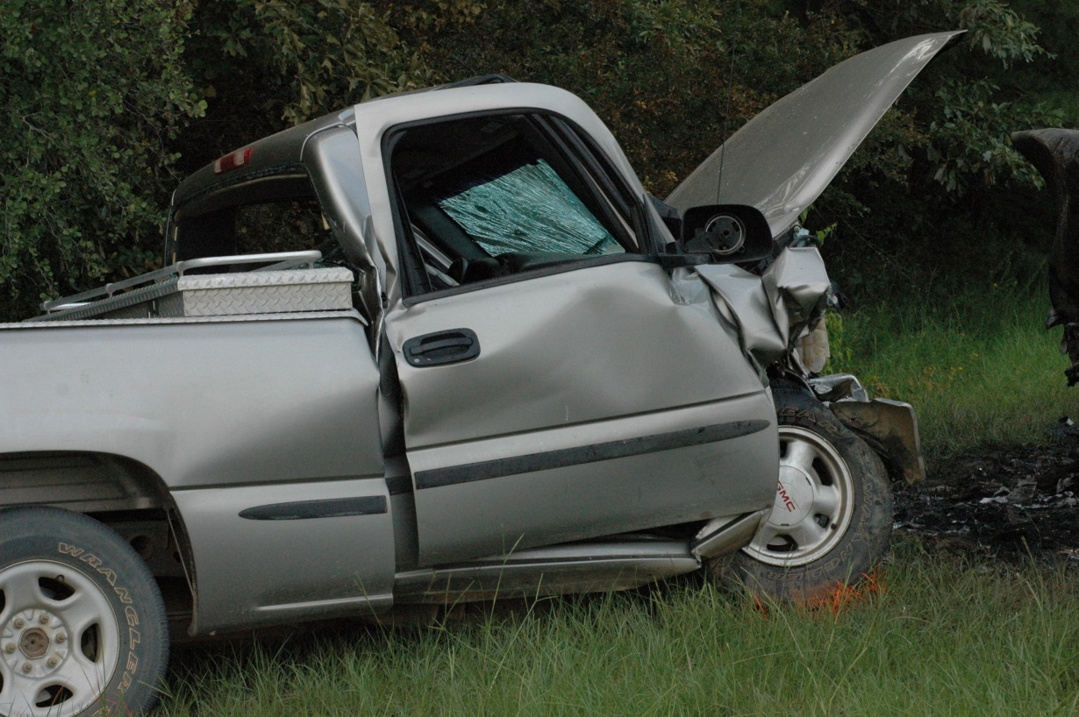
Objective 3.2.7
Support collision analysis and trends.

Slide 39
Goal 3: Potential Negative Impacts
DPS increased dependence on computerized information systems to carry out its operations and to process, maintain, and report essential information …
Noncompliance with federal, state, and other requirements for information security negatively impacts operations with the introduction of sanctions which can result in the loss of certification and authorization to access and manage information necessary to carry out the DPS mission.
Public is not informed of traffic safety initiatives and is unable to make prudent decisions.

Slide 40
Goal 3: Potential Negative Impacts
DPS employees and services are inefficient. This results in poor service and higher cost to conduct business.
Agency expenditures on technology equipment is not efficient and services may suffer.
Efficiency in emergency evacuation to ensure accurate information is provided for public safety.
Agency resources are not properly directed to areas that are most beneficial to the public. Collision reports are not transmitted properly.

Slide 41
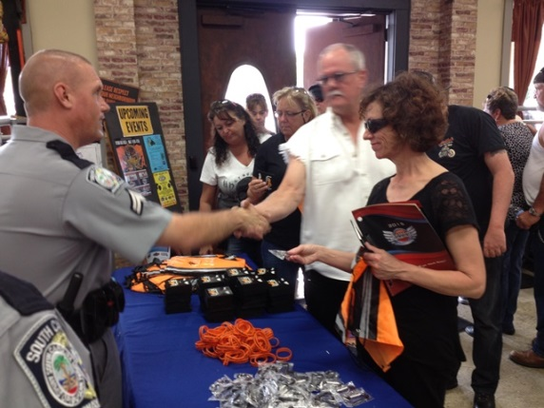
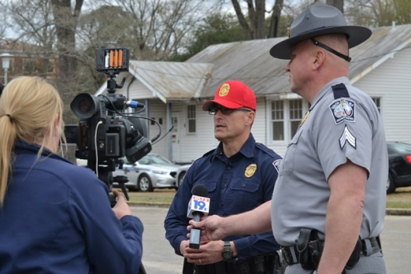
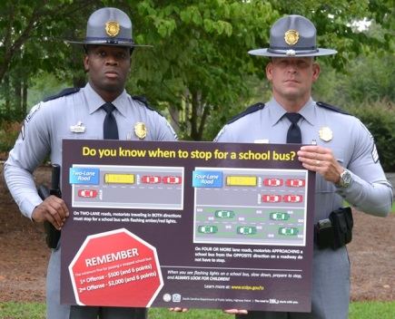
Goal 4: Quality Customer Service Delivery

Slide 42
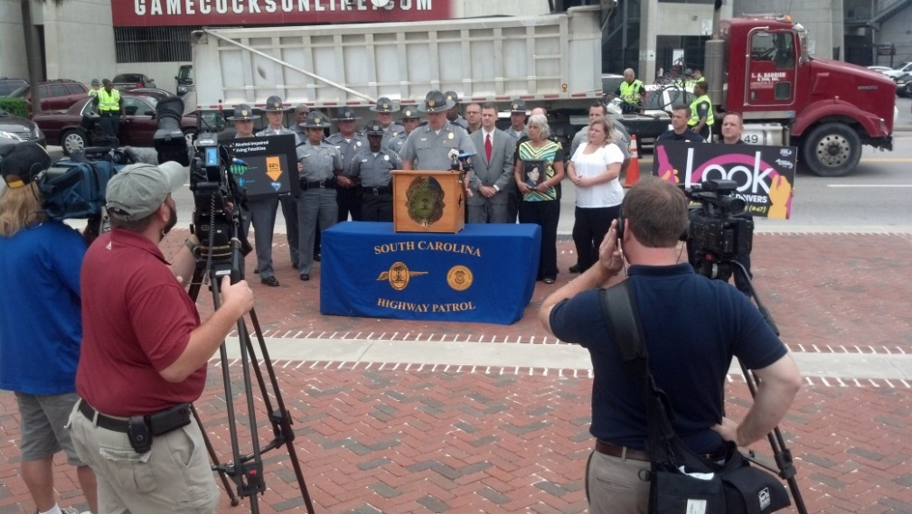
Strategy 4.1 – Ensure Continuous Improvement of Customer Service / Respond to Information Needs of the Public
**4.1.1, 4.1.2, 4.1.3, 4.1.4, 4.1.5 (these are referenced with like objectives in other sections)

Slide 43
Strategy 4.2 – Responsive to Information Needs of the Public

Slide 44

Objective 4.2.1
Respond to all Freedom of Information Act requests in a timely and accurate manner.
Objective 4.2.2
Respond to 100% of all “Requests for Data Reviews”.

Slide 45
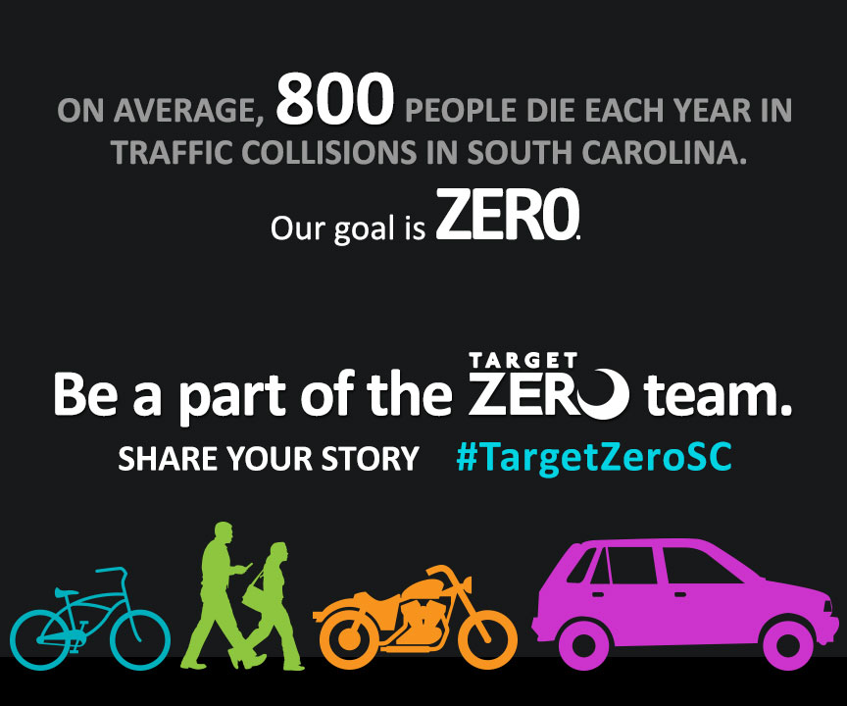
Objective 4.2.3
Utilize social media (Facebook and Twitter) to transmit valuable traffic and safety information to the public.
**Objective 4.2.6
Utilize the DPS web page to disseminate important traffic and safety information to the media and public.

Slide 46
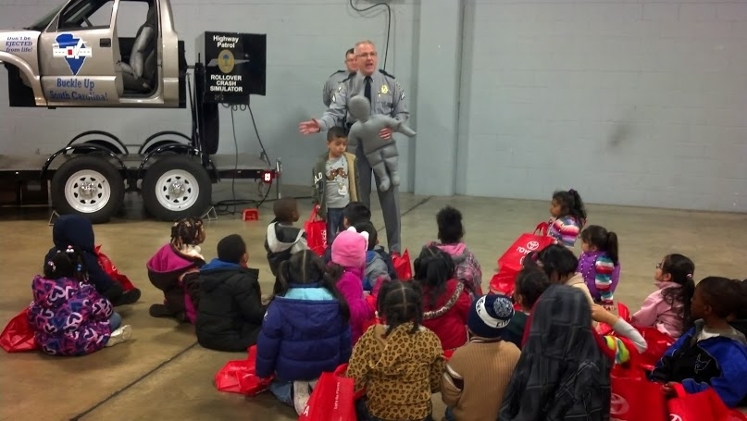
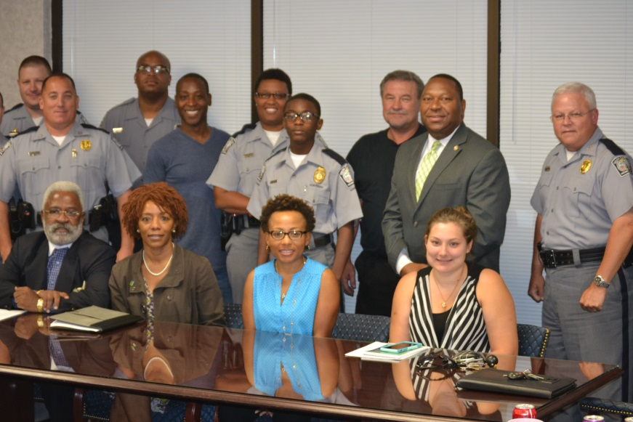
Objective 4.2.4
Conduct safety events, fairs, presentations, and community outreach. Community Relations Officers (CROs) also distribute safety materials, use the driving simulator, rollover simulator, and golf cart goggles.

Slide 47
Goal 4: Potential Negative Impacts
Local agencies will not have a complete understanding of enforcement of immigration laws in their communities.
Victims of crime will not receive the proper services that they need.
Public is not informed of traffic safety initiatives and is unable to make prudent decisions.
Complex collision investigations do not receive the proper investigation that could be conducted.

Slide 48
Goal 4: Potential Negative Impacts
Requested information will not be distributed in the specified timeframe.
The department will not be able to respond to Data Q inquiries as quickly which could lead to unsafe commercial motor vehicles not being removed from service.
Traffic fatalities result in loss of life, emotional pain, lost income, higher insurance rates, and other economic loss. Increasing seat belt usage has proven to reduce traffic fatalities.

Slide 49
Closing and Questions
Director Leroy Smith, SCDPS

